Slide 1

DATA607 Final Project – Financial Wellness Models

Slide 2
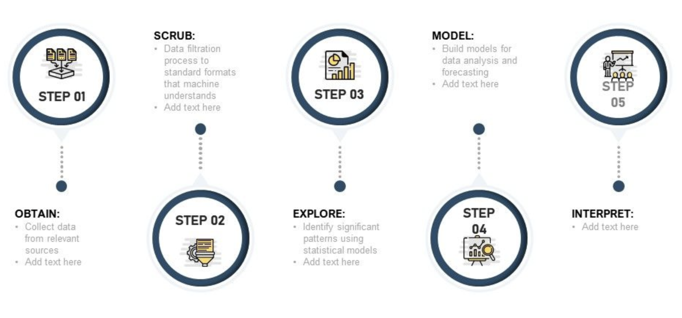
Content
Overview
Workflow
Obtain
Scrub
Explore
Model
iNterpret
Conclusion
Scrub:
Data filtration process to standardize format for modeling
Model:
Build models for data analysis and forecasting
Obtain:
Collect data from relevant sources
Explore:
Identify significant patterns using statistical models
iNterpret:
Explore results in the context of analysis goals

Slide 3
Overview
When people are in control of their money, they’re in control of their lives. They’re happier, less anxious and more empowered. [https://www.nudge-global.com]
Key to developing financial wellness in the general population is understanding how to measure it and what factors impact it. The goal of this project is to explore the measurements of financial wellness and the factors that determine it.
Research Question: What factors impact consumer financial wellbeing and how do you model the relationship?

Slide 4
Overview
Consumer Financial Protection Bureau (PUF)
Survey questions | 10 finwell question | cfpb score
demographic, economic, household structure, attitudes | cfpb score questions | calculated score using the 10 questions from the survey
Federal Reserve System (SHED)
cfpb score | 10 finwell questions | Survey questions
calculated score using the 10 questions from the survey | cfpb score questions | demographic, economic, household structure, attitudes
=
Models
Neuralnet

Slide 5
1. Obtain
CFPB National Financial Well-Being Survey Public Use File (PUF)
Raw data (observations: 6,394 / variables: 217)
Filtered data (observations: 4,000 / variables: 24)
The PUF includes:
demographic data
assessment of financial knowledge
financial positions
financial products owned
financial well-being scale
Federal Reserve System - Survey of Household Economic and Decision making (SHED)
Raw data (observations: 11,648 / variables: 372)
Filtered data (observations: 4,000 / variables: 43)
The SHED includes:
demographic data
assessment of financial knowledge
financial products owned
financial positions
economic fragility
financial well-being scale

Slide 6
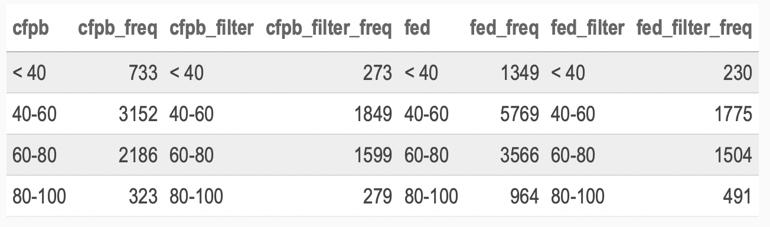
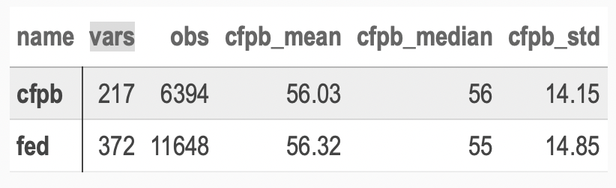
2. Scrub – CFPB Data
Variable Selection – selected 24 variables
Transformation – converted fields to UTF-8, truncated longer text fields, factored columns and added a classification for the cfpb score
Filtering – reduced data set to 4,000
Outliers – filtered cfpb scores less than 0

Slide 7
2. Scrub – FED Data
Variable Selection – selected 43 relevant variables
Transformation - converted fields to UTF-8, factored columns and added a classification for the cfpb score
Filtering - reduced data set to 4,000
Outliers – no outliers filtered

Slide 8
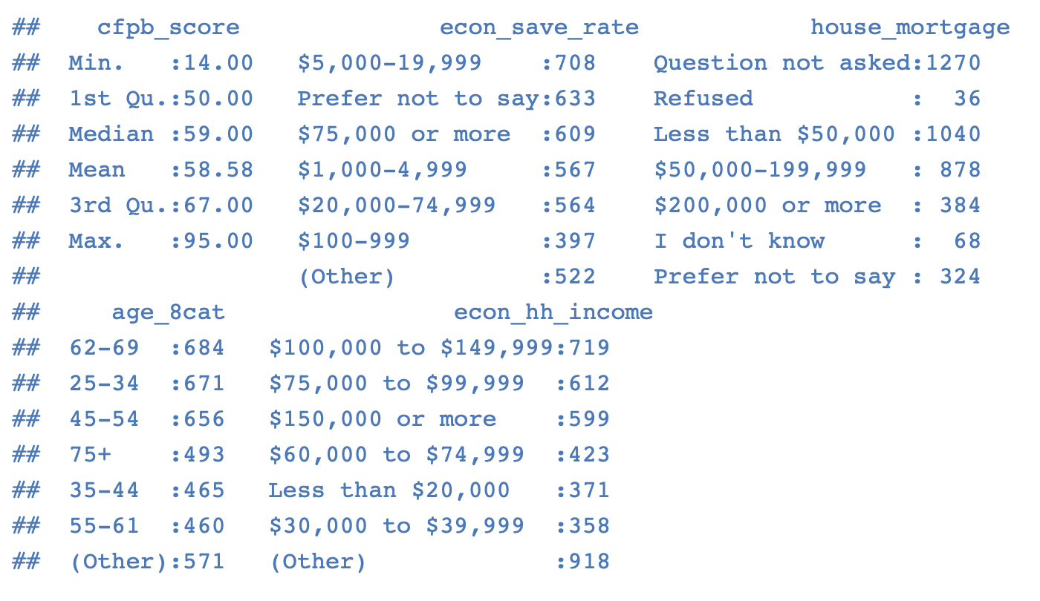
3. Explore - CFPB
Low correlation across numeric values - there are limited numeric values in the survey data. The numeric data that exists is not heavily correlated
Correlation varies by education and income level - there is a difference in correlation across education levels and income groups
Segmenting the population using these variables is an avenue for further analysis

Slide 9
3. Explore - CFPB

Slide 10
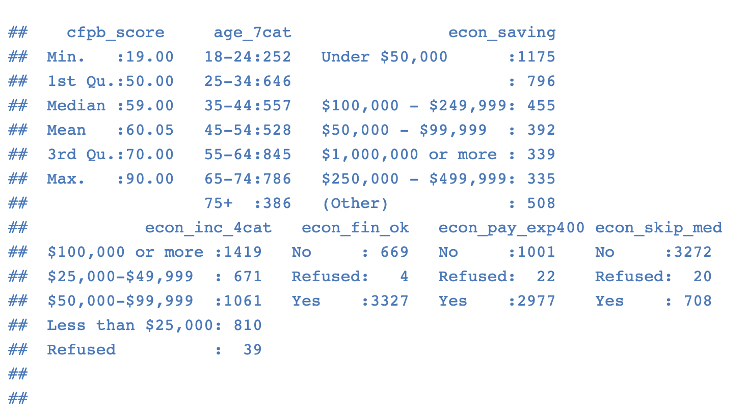
3. Explore – Fed
Few numeric variables with limited correlations - similar to the CFPB survey data the Federal Reserve survey data reflects low correlation between the numeric variables in the data set.
The numeric numbers that exist primarily focus on house hold composition.
Survey data includes non complete records - the second phase of the analysis would be to identify smaller subset of the variable and review the impact of incomplete data sets and outliers.

Slide 11
3. Explore – Fed

Slide 12
4. Model
The analysis includes the following models:
linear regression model using parsnip packages from tidy models – focus of the analysis
random forest model using parsnip packages from tidy models – explore categorical model
neural network model using the neuralnet package
Neuralnet

Slide 13
4. Model – variable selection
Using backwards elimination to define optimal model:
econ_save_rate
house_mortgage
age_8cat
econ_hh_income
Using backwards elimination to define optimal model:
age_7cat
econ_saving
econ_inc_4cat
econ_fin_ok
econ_pay_exp400
econ_skip_med

Slide 14
4. Model – Linear Regression
CFPB | # training
 | Adjusted R² | 0.4118
 | Residual std error | 10.37
 | # testing
 | Root Mean Sq Err | 10.6
 | R² | 0.427
FED | # training
 | Adjusted R² | 0.4808
 | Residual std error | 10.38
 | # testing
 | Root Mean Sq Err | 10.6
 | R² | 0.469

Slide 15
4. Model – Random Forest
CFPB | # training
 | accuracy | 0.455
 | roc_auc | 0.779
 | # testing
 | accuracy | 0.505
 | roc_auc | 0.782
FED | # training
 | accuracy | 0.468
 | roc_auc | 0.641
 | # testing
 | accuracy | 0.453
 | roc_auc | 0.605

Slide 16
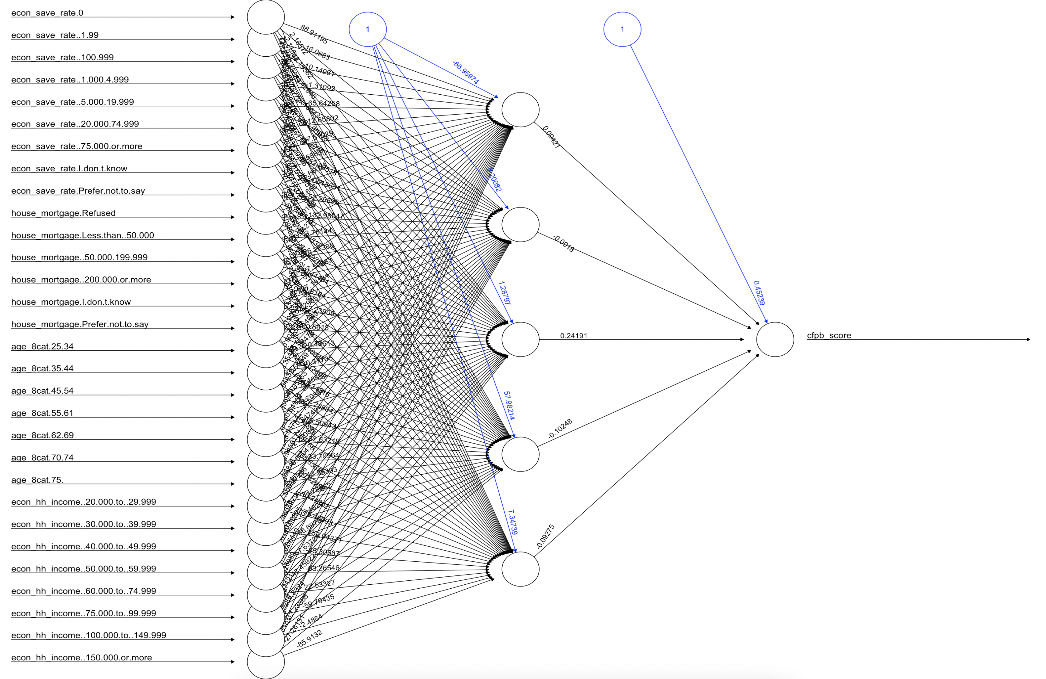
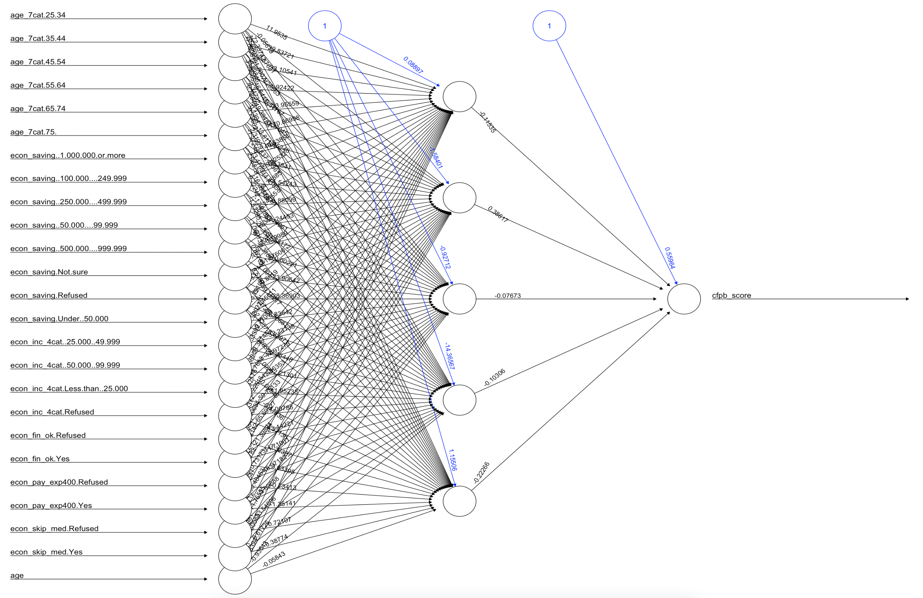
4. Model – Neural Network

Slide 17
5. iNterpret
The testing of the model indicates a clear relationship between the model variables and the observed cfpb score for the surveyed individuals
The residual graph indicates outliers at the low end and the higher end of the cfpb score. Studying those segments of the population might provide some additional insight into the relevance of the cfpb score to the respective populations
Unsurprisingly variables representing savings rate, age and income appear in both models (explain more than 40% of your wellness score)
It is interesting that race, gender, education, household composition and education levels are not part of the model

Slide 18
Conclusion
Linear regression model more effective - The linear regression model was more effective than the random forest or neural network models. The random forest and neural network models struggled to differentiate cases at the high end and the low end of the cfpb score spectrum.
Importance of early decisions - The technical execution of the analysis is important but early decision on the data to include or exclude in the analysis has a large impact on the shape of the model. This analysis utilized several models with each model generating slightly different results.
More analysis - I had not expected to resolve any longstanding debates in the financial industry but it has been surprising how many different avenues for analysis or questions arose from this discussion.

